Slide 1
Chapter – 7 system integration testing

Slide 2
Outline of the Chapter
The Concept of Integration Testing
Different Types of Interfaces
Different Types of Interface Errors
Granularity of System Integration Testing
System Integration Techniques: Incremental, Top-down, Bottom-up, and Sandwich and Big-bang
Test Plan for System Integration
Off-the-shelf Component Testing

Slide 3
The Concept of Integration Testing
A software module is a self-contained element of a system
Modules are individually tested commonly known as unit testing
Next major task is to put the modules, i.e., pieces together to construct the complete system
Construction of a working system from the pieces is not a straightforward task because of numerous interface errors
The objective of system integration testing (SIT) is to build a “working” version of the system
Putting modules together in an incremental manner
Ensuring that the additional modules work as expected without disturbing the functionalities of the modules already put together
Integration testing is said to be complete when
The system is fully integrated together
All the test cases have been executed
All the severe and moderated defects found have been fixed

Slide 4
The Concept of Integration Testing
Interface errors cannot be detected by performing unit testing on modules since unit testing causes computation to happen within a module, whereas interactions are required to happen between modules for interface errors to be detected.
The major advantages of conducting SIT are as follows:
Defects are detected early
It is easier to fix defects detected earlier
We get earlier feedback on the health and acceptability of the individual modules and on the overall system
Scheduling of defect fixes is flexible, and it can overlap with the development

Slide 5
Different Types of Interfaces
Modularization is an important principle in software design, and modules are interfaced with other modules to realize the system’s functional requirements.
An interface between two modules allows one module to access the service provided by the other.
It implements a mechanism for passing control and data between modules.
Three common paradigms for interfacing modules:
Procedure call interface
Shared memory interface
Message passing interface
The problem arises when we “put modules together” because of interface errors
Interface errors
Interface errors are those that are associated with structures existing outside the local environment of a module, but which the module uses

Slide 6
Different Types of Interface Errors
Construction
Inadequate functionality
Location of functionality
Changes in functionality
Added functionality
Misuse of interface
Misunderstanding of interface
Data structure alteration
Inadequate error processing
Additions to error processing
Inadequate post-processing
Inadequate interface support
Initialization/value errors
Validation of data constraints
Timing/performance problems
Coordination changes
Hardware/software interfaces

Slide 7
Granularity of System Integration Testing
System Integration testing is performed at different levels of granularity
Intra-system testing
This form of testing constitutes low-level integration testing with the objective of combining the modules together to build a cohesive system
Inter-system testing
It is a high-level testing phase that requires interfacing independently tested systems
For example, Integrating a call control system and a billing system in a telephone network is another example of intersystem testing
Pairwise testing
In pairwise integration, only two interconnected systems in an overall system are tested at a time
The purpose of pairwise testing is to ensure that two systems under consideration can function together, assuming that the other systems within the overall environment behave as expected

Slide 8
System Integration Techniques
One of the objectives of integration testing is to combine the software modules into a working system so that system-level tests can be performed on the complete system.
Integration testing need not wait until all the modules of a system are coded and unit tested. Instead, it can begin as soon as the relevant modules are available.
Common approaches to perform system integration testing
Incremental
Top-down
Bottom-up
Sandwich
Big-bang

Slide 9
Incremental
Integration testing is conducted in an incremental manner as a series of test cycles
In each test cycle, a few more modules are integrated with an existing and tested build to generated larger builds
The complete system is built, cycle by cycle until the whole system is operational for system-level testing.
The number of SIT cycles and the total integration time are determined by the following parameters:
Number of modules in the system
Relative complexity of the module (cyclomatic complexity)
Relative complexity of the interfaces between the modules
Number of modules needed to be clustered together in each test cycle
Whether the modules to be integrated have boon adequately tested before
Turnaround time for each test-debug-fix cycle

Slide 10
Incremental
A software image is a compiled software binary
A build is an interim software image for internal testing within an organization
Constructing a build is a process by which individual modules are integrated to form an interim software image.
The final build is a candidate for system testing
Constructing a software image involves the following activities
Gathering the latest unit tested, authorized versions of modules
Compiling the source code of those modules
Checking in the compiled code to the repository
Linking the compiled modules into subassemblies
Verifying that the subassemblies are correct
Exercising version control

Slide 11
Incremental
Creating a daily build is very popular among many organization
It facilitates to a faster delivery of the system
It puts emphasis on small incremental testing
It steadily increases number of test cases
The system is tested using automated, re-usable test cases
An effort is made to fix the defects that were found within 24 hours
Prior version of the build are retained for references and rollback
A typical practice is to retain the past 7-10 builds

Slide 12
Incremental
A release note containing the following information accompanies a build.
What has changed since the last build?
What outstanding defects have been fixed?
What are the outstanding defects in the build?
What new modules, or features, have been added?
What existing modules, or features, have been enhanced, modified, or deleted?
Are there any areas where unknown changes may have occurred?
A test strategy is created for each new build and the following issues are addressed while planning a test strategy
What test cases need to be selected from the SIT test plan?
What previously failed test cases should now be re-executed in order to test the fixes in the new build?
How to determine the scope of a partial regression tests?
What are the estimated time, resource demand, and cost to test this build?

Slide 13
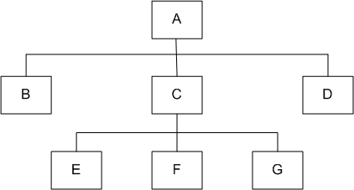
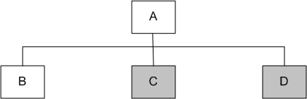
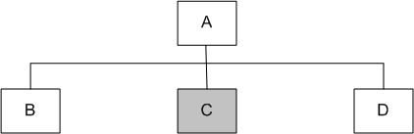
Top-down
Module A has been decomposed into modules B, C, and D
Modules B, D, E, F, and G are terminal modules
First integrate modules A and B using stubs C` and D` (represented by grey boxes)
Next stub D` has been replaced with its actual instance D
Two kinds of tests are performed:
Test the interface between A and D
Regression tests to look for interface defects between A and B in the presence of module D
Figure 7.1: A module hierarchy with three levels and seven modules
Figure 7.3: Top-down integration of modules A, B and D
Figure 7.2: Top-down integration of modules A and B

Slide 14
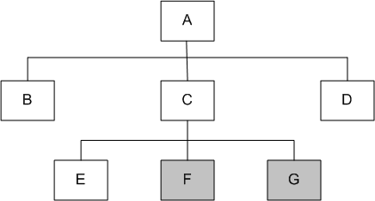
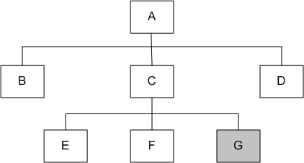
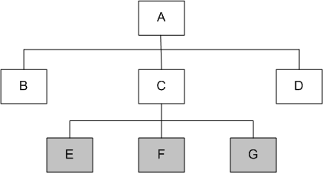
Top-down
Stub C` has been replaced with the actual module C, and new stubs E`, F`, and G`
Perform tests as follows:
first, test the interface between A and C;
second, test the combined modules A, B, and D in the presence of C
The rest of the process depicted in the right hand side figures.
Figure 7.5: Top-down integration of modules A, B, C, D and E
Figure 7.6: Top-down integration of modules A, B, C, D, E and F
Figure 7.4: Top-down integration of modules A, B, D and C

Slide 15
Top-down
Advantages
The SIT engineers continually observe system-level functions as the integration process continue
Isolation of interface errors becomes easier because of the incremental nature of the top-down integration
Test cases designed to test the integration of a module M are reused during the regression tests performed after integrating other modules
Disadvantages
It may not be possible to observe meaningful system functions because of the absence of lower-level modules and the presence of stubs.
Test case selection and stub design become increasingly difficult when stubs lie far away from the top-level module.

Slide 16
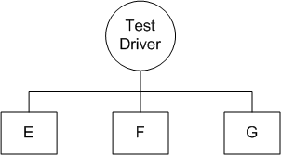
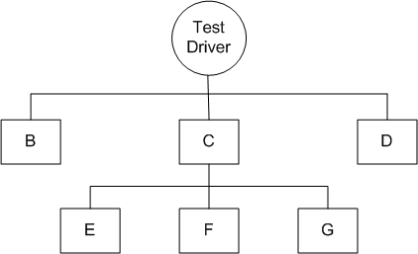
Bottom-up
We design a test driver to integrate lowest-level modules E, F, and G
Return values generated by one module are likely to be used in another module
The test driver mimics module C to integrate E, F, and G in a limited way.
The test driver is replaced with actual module , i.e., C.
A new test driver is used
At this moment, more modules such as B and D are integrated
The new test driver mimics the behavior of module A
Finally, the test driver is replaced with module A and further test are performed
Figure 7.8: Bottom-up integration of module E, F, and G
Figure 7.9: Bottom-up integration of module B, C, and D with F, F, and G

Slide 17
Bottom-up
Advantages
One designs the behavior of a test driver by simplifying the behavior of the actual module
If the low-level modules and their combined functions are often invoked by other modules, then it is more useful to test them first so that meaningful effective integration of other modules can be done
Disadvantages
Discovery of major faults are detected towards the end of the integration process, because major design decisions are embodied in the top-level modules
Test engineers can not observe system-level functions from a partly integrated system. In fact, they can not observe system-level functions until the top-level test driver is in place

Slide 18
Big-bang and Sandwich
Big-bang Approach
First all the modules are individually tested
Next all those modules are put together to construct the entire system which is tested as a whole
Sandwich Approach
In this approach a system is integrated using a mix of top-down, bottom-up, and big-bang approaches
A hierarchical system is viewed as consisting of three layers
The bottom-up approach is applied to integrate the modules in the bottom-layer
The top layer modules are integrated by using top-down approach
The middle layer is integrated by using the big-bang approach after the top and the bottom layers have been integrated

Slide 19
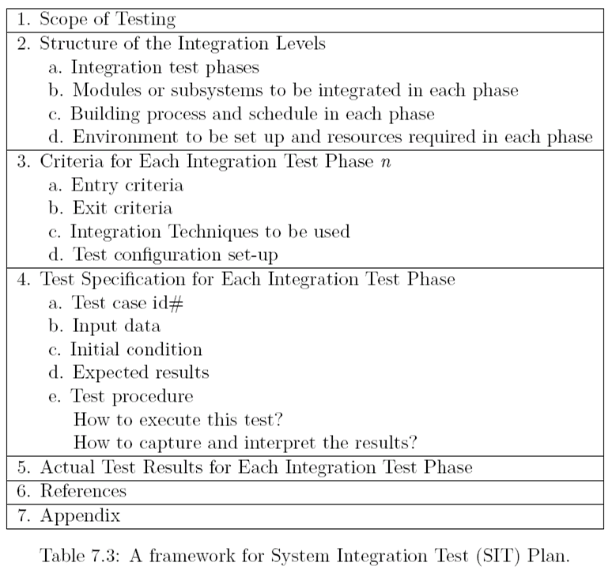
Test Plan for System Integration

Slide 20
Test Plan for System Integration
Categories of System Integration Tests:
Interface integrity
Internal and external interfaces are tested as each module is integrated
Functional validity
Tests to uncover functional errors in each module after it is integrated
End-to-end validity
Tests are designed to ensure that a completely integrated system works together from end-to-end
Pairwise validity
Tests are designed to ensure that any two systems work properly when connected by a network
Interface stress
Tests are designed to ensure that the interfaces can sustain the load
System endurance
Tests are designed to ensure that the integrated system stay up for weeks without any crashes

Slide 21
Off-the-self Component Integration
Organization occasionally purchase off-the-self (OTS) components from vendors and integrate them with their own components
Useful set of components that assists in integrating actual components:
Wrapper: It is a piece of code that one builds to isolate the underlying components from other components of the system.
Glue: A glue component provides the functionality to combine different components
Tailoring: Components tailoring refers to the ability to enhance the functionality of a component
Tailoring is done by adding some elements to a component to enrich it with functionality not provided by the vendor
Tailoring does not involve modifying the source code of the component
For example, executing some “script” when some event occurs.

Slide 22
Off-the-shelf Component Testing
OTS components produced by the vendor organizations are known as commercial off-the-shelf (COTS) components
A COTS component is defined as: “A unit of composition with contractually specified interfaces and explicit context dependencies only. A software component can be deployed independently and is subject to composition by third parties.”
Three types of testing techniques are used to determine the suitability of a COTS component:
Black-box component testing: This is used to determine the quality of the component
System-level fault injection testing: This is used to determine how well a system will tolerate a failing component
Operational system testing: These kinds of tests are used to determine the tolerance of a software system when the COTS component is functioning correctly to determine if the OTS component is a good match for the system.

Slide 23
Thank You!!

